Slide 1
Global Conversation on Climate Change

Slide 2

Global Conversation on Climate Change
Environmental Advocacy Group
How can we use Twitter to raise awareness of what we’re doing?
Notes:
Mention retweets

Slide 3
Data Summary and Approach
Rest API
Stream API
Tweet Object
Username
Tweet date
Full text of tweet
Favorite count
Location
Time zone
Followers
Following
Retweets
Storage: mongoDB, AWS EC2
Modelling: LDA, NMF
Word2Vec, Clustering
Sentiment Analysis
Can we group tweets into distinct topics?
How can we use them?
Sample of 180,920 tweets
Feb 18, 2018 to March 5, 2018
#climatechange and #globalwarming
English only
Notes:
Interested in high number of retweets because they indicate high visibility for that tweet
Can these topics help us more effectively use Twitter as a channel to educate the public around the world?

Slide 4
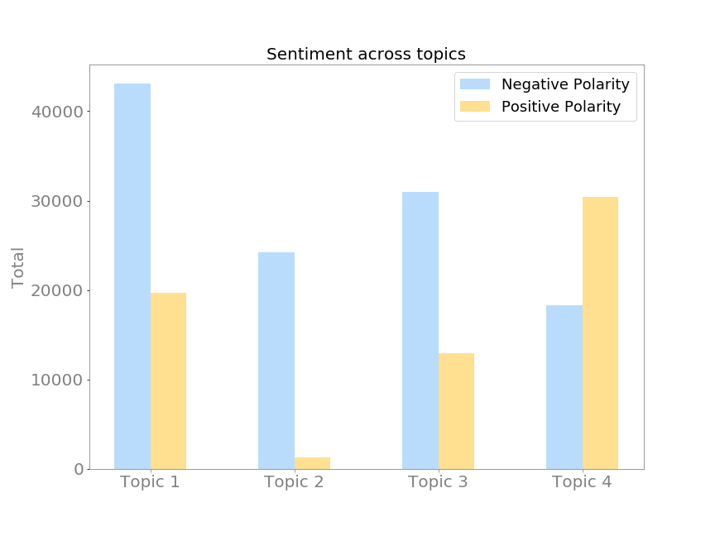
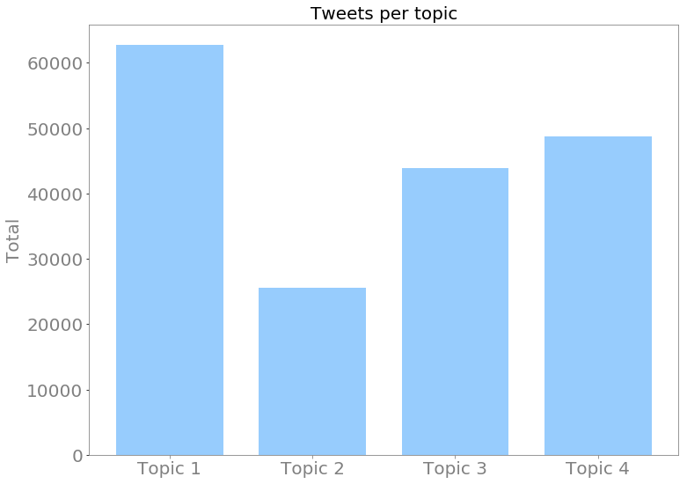
Topics
Topic 1: Discussion and Opinions
Topic 2: News about Climate Change
Topic 3: Observations of weather trends, and their sociological/political impacts
Topic 4: Scientific observations of weather trends
Avg Retweets:
688
69
271
286

Slide 5
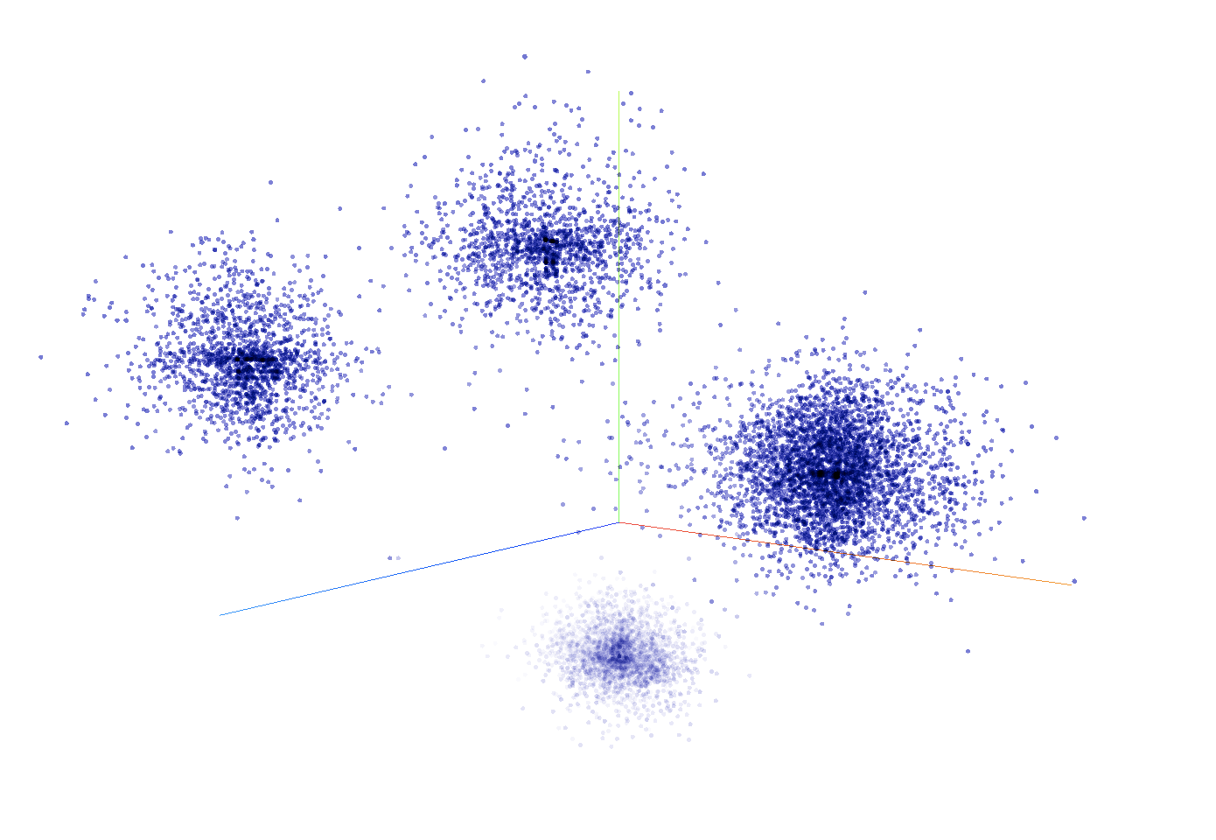
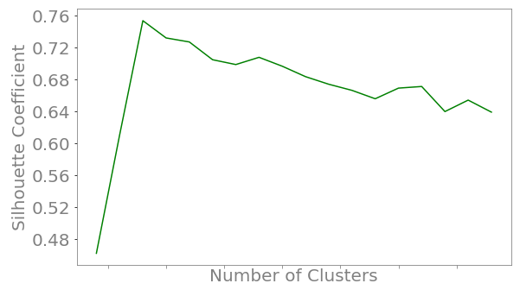
Sanity check: Clustering documents in topic space
T-SNE plot
Silhouette Score
2
5
8
11
14
17
20
4
Notes:
Silhouette score quantifies the quality of clustering

Slide 6
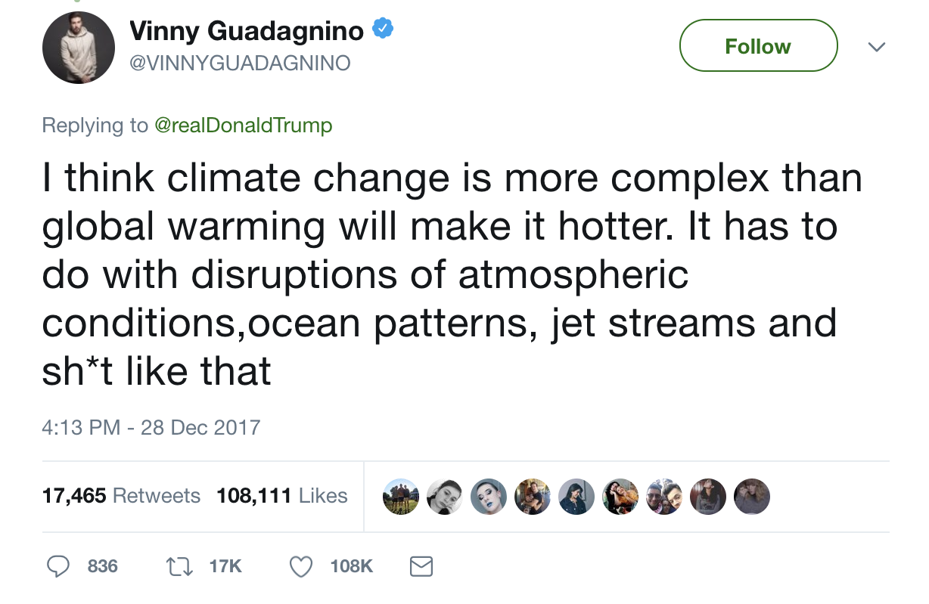
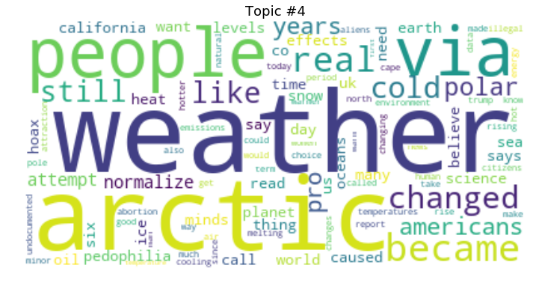
Topic1: Discussion and Opinions
Most retweeted:
Public
Figure
Most frequently used words:
35% tweets
Average retweets: 688
Negative Polarity
Replying
to
Public
Figure

Slide 7
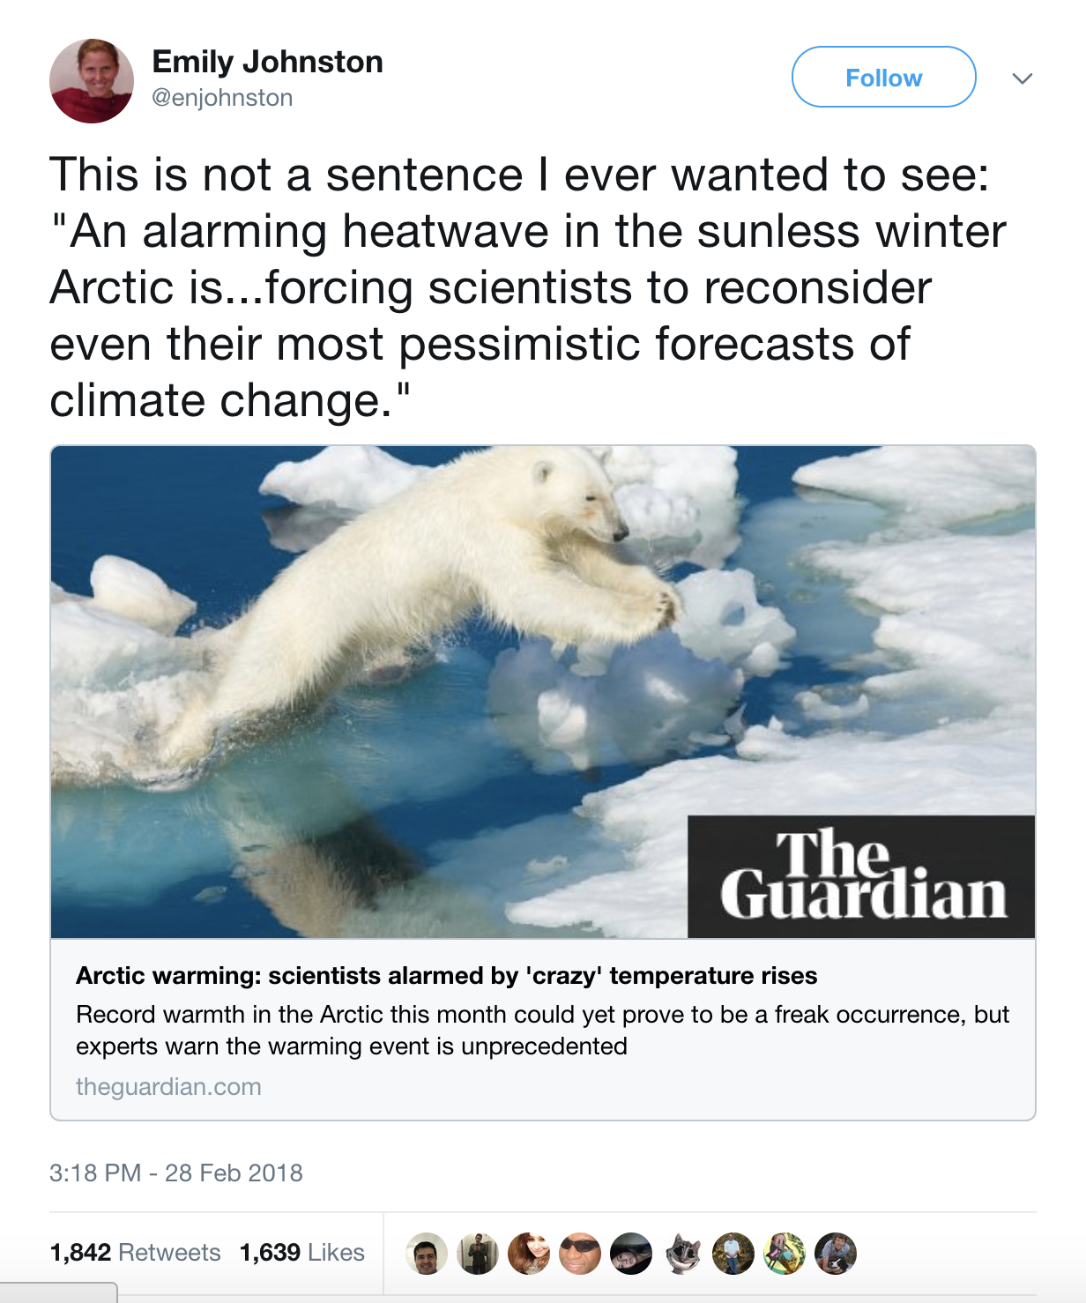
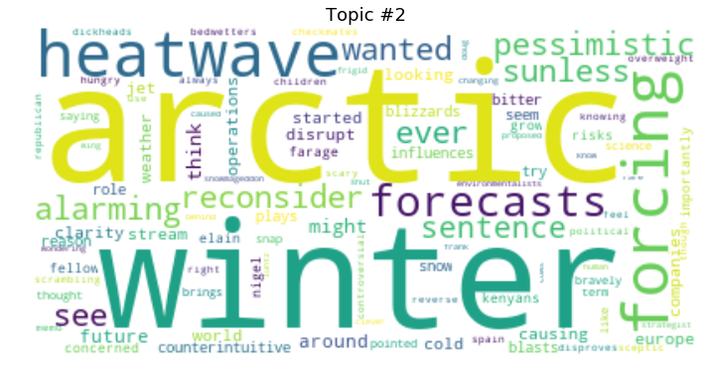
Topic 4: Observations of weather trends
Most retweeted:
Most frequently used words:
27% tweets
Average retweets: 286
Positive Polarity
Focus on
Observations

Slide 8
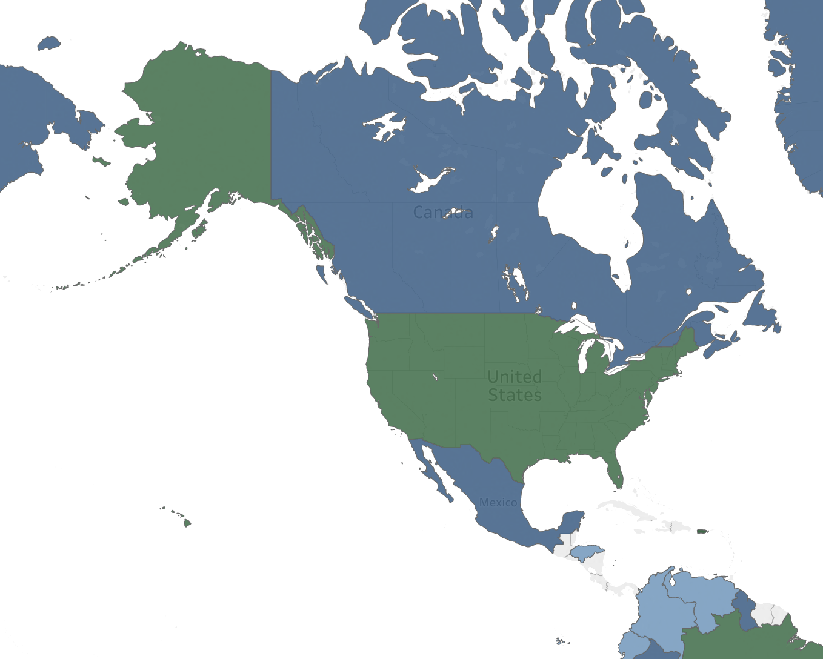

Most tweeted topics around the world
Topic with most tweets: ‘Top Topic’
United States
Topic 1: Discussion and Opinions
35% of tweets
Canada
Topic 4: Observations of weather trends
40% of tweets
Top Topics depend on location
Most retweeted tweets fell in top topic
Canada
United
States
Top Topic
1
2
3
4
Tableau Viz
Notes:
Call topic with the most tweets ‘Top Topic’

Slide 9
What does all this mean?
Best topic to emulate depends on target location
Retweets are more likely in Top Topic
Sentiment varies across Topics

Slide 10
How could we use this information?
Countries with Topic 1:
Eg USA, Australia
Discussion and opinions
Encourage users with large followings
Public figures
Volunteers
Can use negative language
Countries with Topic 4:
Eg. Canada, UK
Observations of weather trends
Encourage organizations
Non Profits
News sites
Use positive language
Notes:
How can our organization use this information to make sure our outreach efforts impact the conversation?

Slide 11
Next Steps
Retweets vs Topics
Global Warming vs Climate Change
Verified vs Unverified Users

Slide 12
Questions

Slide 13
Appendix

Slide 14
Data Summary & Approach
Sample of 180,920 tweets
Feb 18, 2018 to March 5, 2018
Containing #climatechange and #globalwarming
English only
Storage: mongoDB
Preprocessing: pandas
Topic Modelling: LDA, NMF
Other modelling: Word2Vec, Clustering

Slide 15
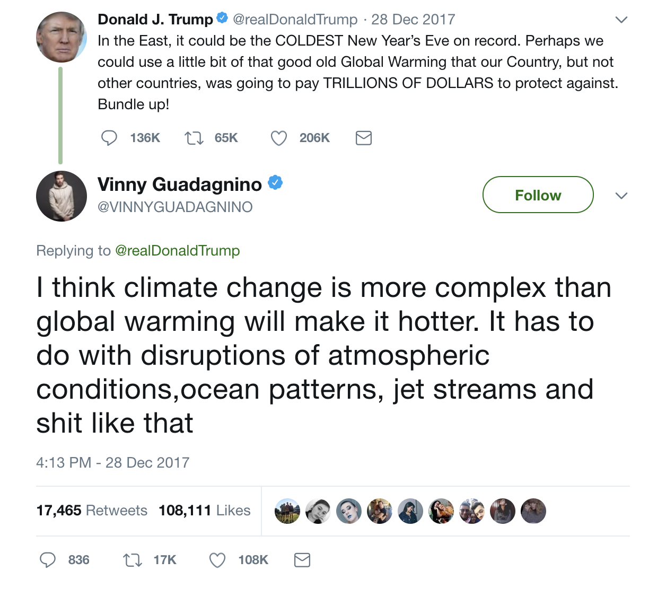
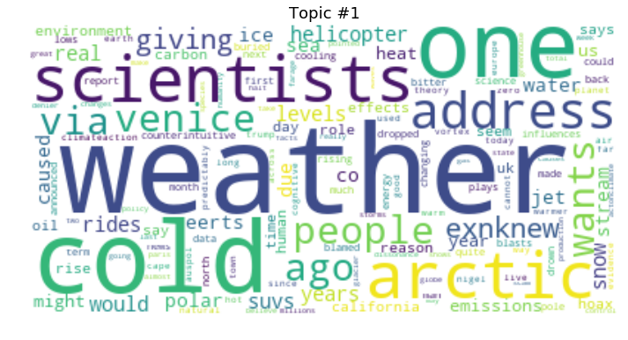
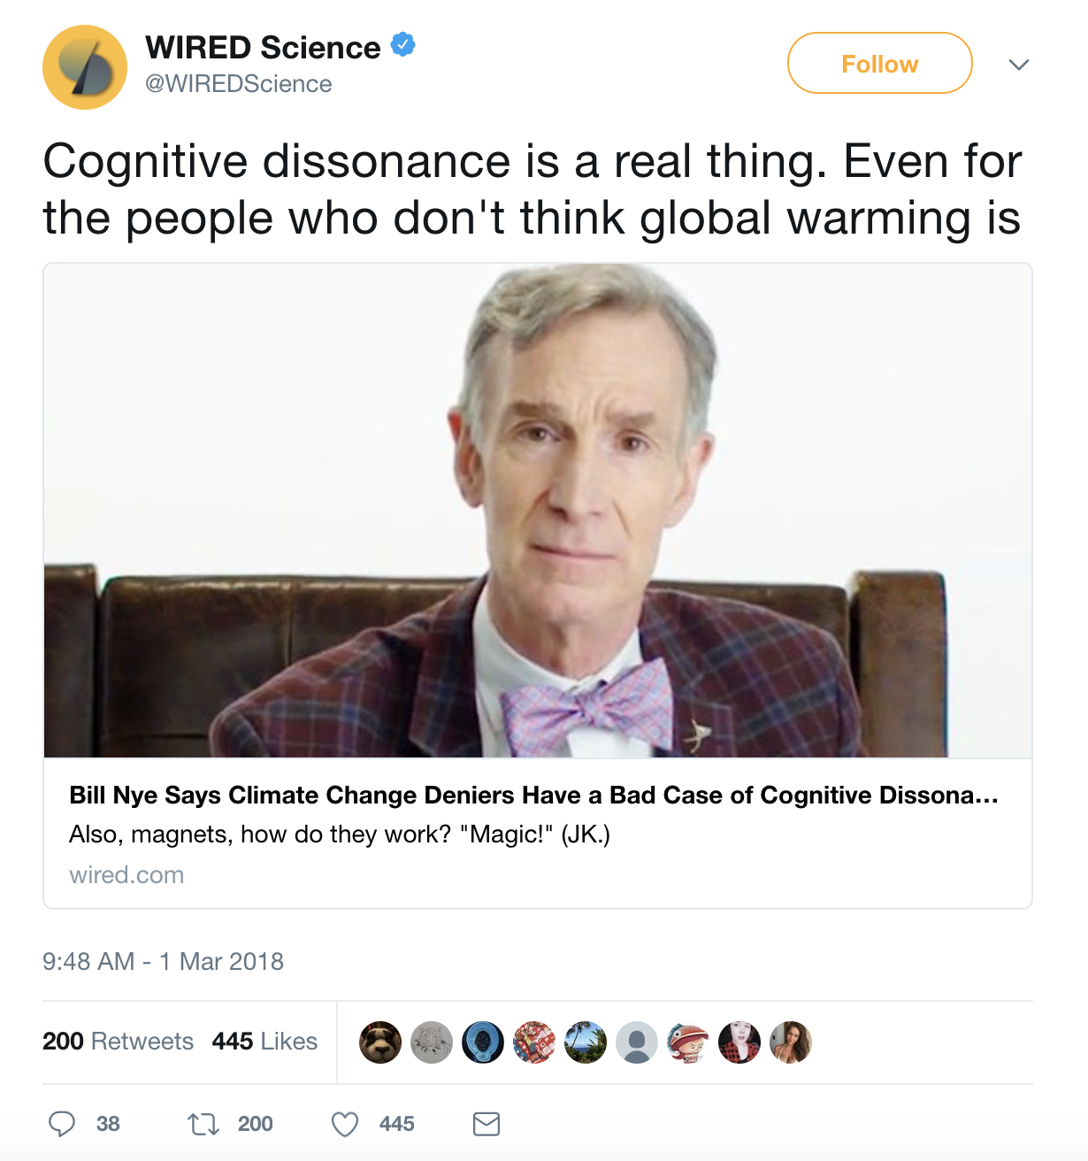
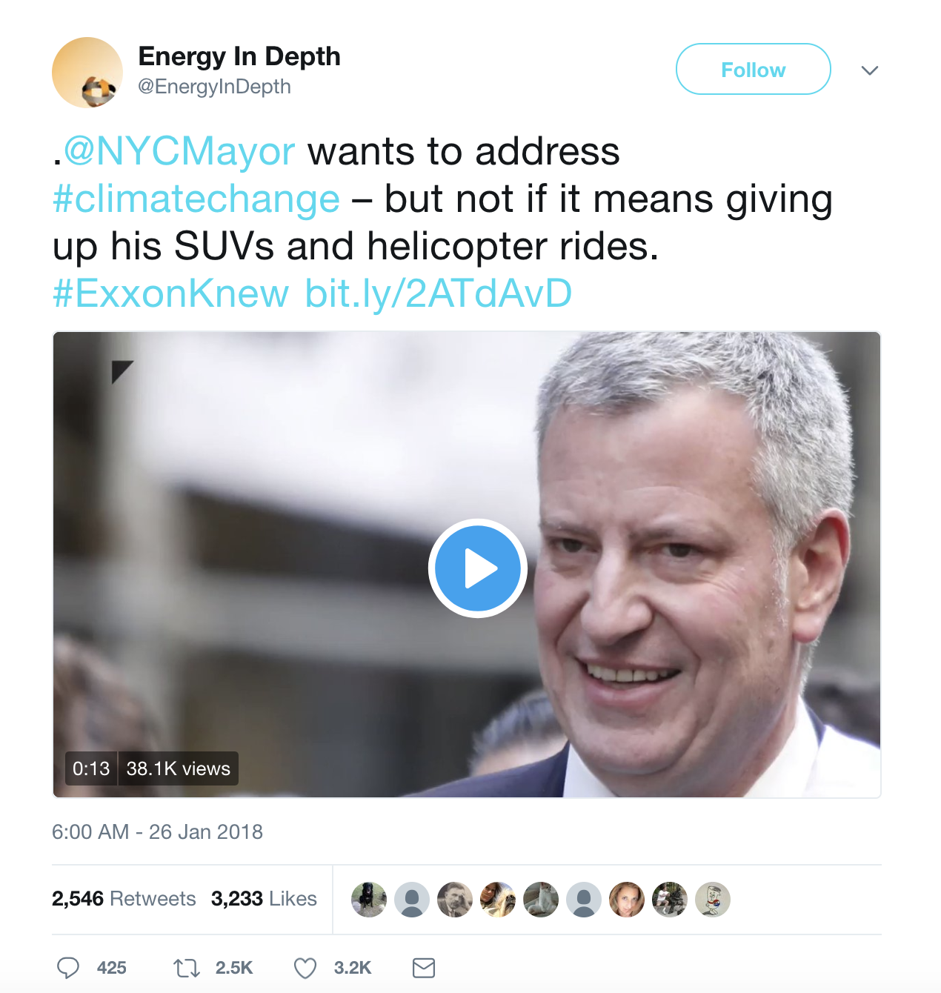
Topic1: Discussion and Opinions
35% tweets (62,749)
Average retweets: 1154
Average likes: 87

Slide 16
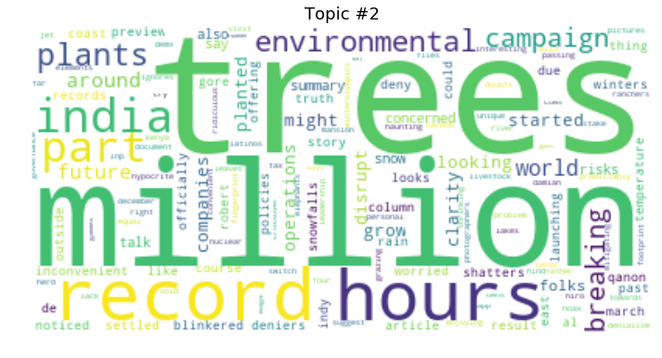
Topic2: Climate Change News
14% tweets (25,533)
Average retweets: 202
Average likes: 260
2 examples

Slide 17
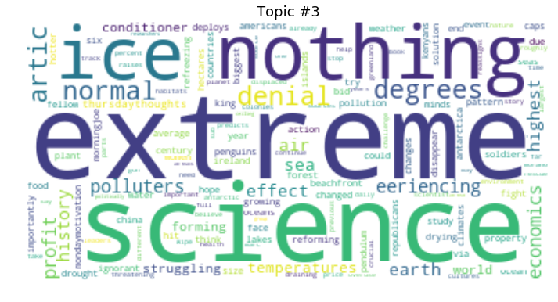
Topic3: Observations of weather trends, and their sociological/political impacts
24% tweets (43,909)
Average retweets: 287
Average likes: 190
2 examples

Slide 18
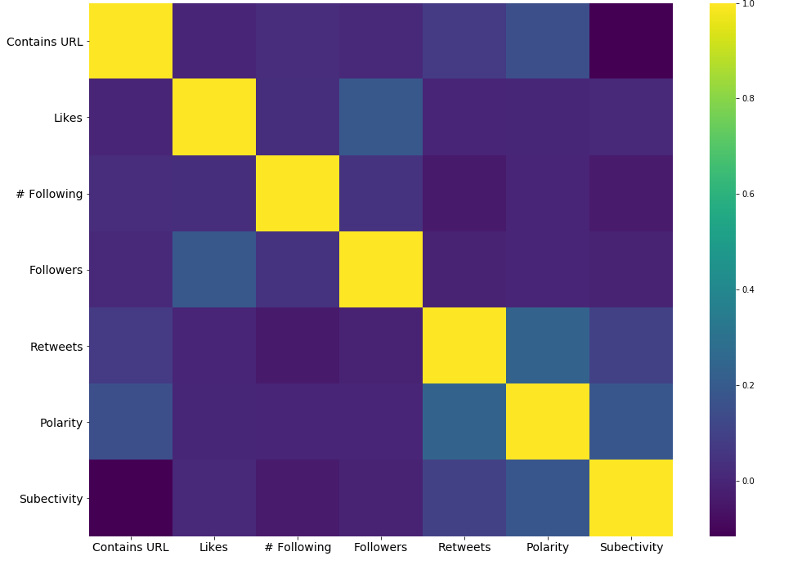
Correlations of Tweet Features
Most highly correlated:
Polarity and Retweets
Likes and Followers

Slide 19
Topics around the world
Demo
Tableau Viz

Slide 20
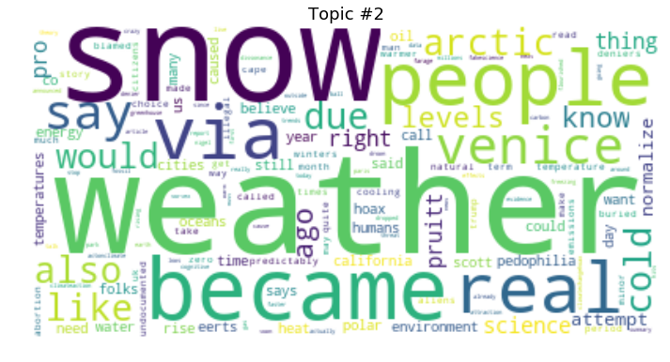
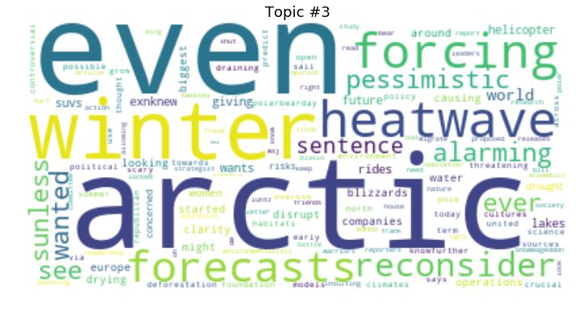

Slide 21
Sentiment Analysis
Retweets v polarity for each topic
Change graph to only topic 1 and 4

